Slide 1
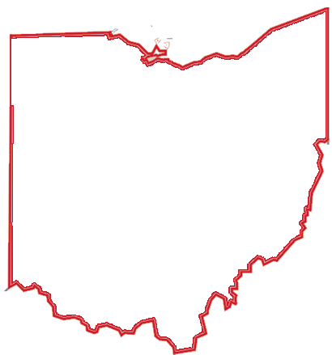
Economic Impact of Black-Owned Businesses in Ohio Ohio Black Expo Level Up Business Conference David Mahon, Ph.D.
May 25, 2023
david.mahon@uc.edu
economicsresearch.org
Notes:
Good morning! My name is David Mahon and I am the Executive Director of the Alpaugh Family Economics Center for Education and Research. I am honored to address this year’s Black Expo to discuss the Economic Impact of Black-owned Businesses in Ohio.

Slide 2
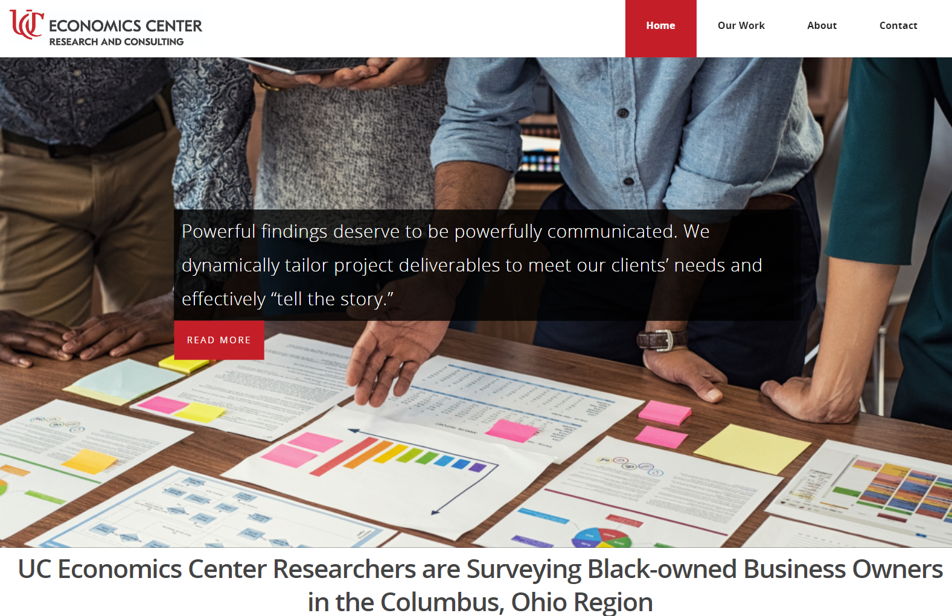
david.mahon@uc.edu
economicsresearch.org
Notes:
Our organization conducts research for government, corporate, and non-profit clients including benefit cost and economic impact analyses. You’ll see an example of our work today.

Slide 3
Why is this important?
Black-owned businesses play a crucial role in our society and economy. A key way to drive inclusive economic growth and increase wealth for Black people.
Black entrepreneurs embody innovation, resilience, and creativity, all in in the face of adversity, hardship, and structural barriers.
Motivation
david.mahon@uc.edu
economicsresearch.org
Notes:
I’ll motivate this talk by noting why this is so important. Black-owned businesses are not just mere establishments for commerce; they are an embodiment of creativity, innovation, and resilience, all while facing adversity, hardship, and structural barriers. They play a key role in fostering inclusive economic growth and wealth accumulation within Black communities.

Slide 4
Firms, Employees, Payroll, and Receipts for Black-owned Businesses in Ohio
Our Work: Economic Impact in SW Ohio
Challenges
Progress and Opportunities
david.mahon@uc.edu
economicsresearch.org
Notes:
Today, our discussion will be centered around four main themes: The impact of Black-owned businesses in terms of firms, employees, payroll, and receipts in Ohio, our specific work in Southwestern Ohio, the challenges these businesses face, and finally, the progress made and opportunities that lie ahead.

Slide 5
Firms, Employees, Payroll, and Receipts for Black-owned Businesses in Ohio
4,206
Employee Businesses
david.mahon@uc.edu
economicsresearch.org

Slide 6
Firms, Employees, Payroll, and Receipts for Black-owned Businesses in Ohio
55,112
Employees
david.mahon@uc.edu
economicsresearch.org

Slide 7
Firms, Employees, Payroll, and Receipts for Black-owned Businesses in Ohio
More than $1.5B
Payroll
david.mahon@uc.edu
economicsresearch.org

Slide 8
Firms, Employees, Payroll, and Receipts for Black-owned Businesses in Ohio
Receipts Exceeded $5B
david.mahon@uc.edu
economicsresearch.org

Slide 9
98,780 nonemployer Black-owned businesses with receipts totaling more than $2B in revenues. (2019)
david.mahon@uc.edu
economicsresearch.org

Slide 10
Cleveland
80%
Columbus
Cincinnati
david.mahon@uc.edu
economicsresearch.org

Slide 11
Our Work: Economic Impact in SW Ohio
david.mahon@uc.edu
economicsresearch.org

Slide 12
Our Work: Economic Impact in SW Ohio
david.mahon@uc.edu
economicsresearch.org

Slide 13
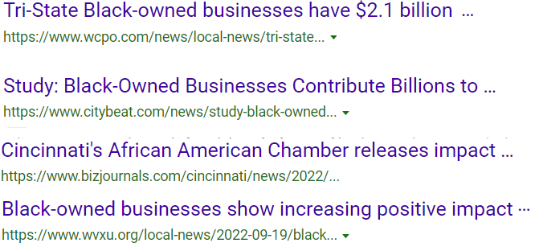
Our Work: Economic Impact in SW Ohio
david.mahon@uc.edu
economicsresearch.org

Slide 14
Challenges
Access to Capital - More likely to be denied, more likely to not apply, higher interest rates when they do.
Widespread discrimination in operations.
Most concerned about financial health of the business
david.mahon@uc.edu
economicsresearch.org

Slide 15
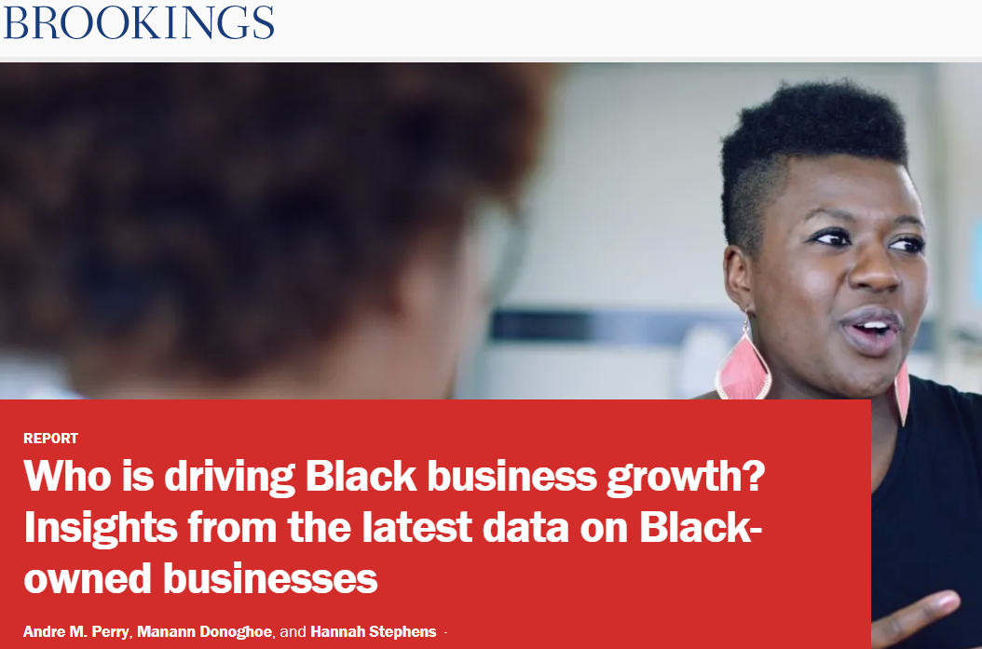
Black-owned business growth is fueled in part by Black women.
“17% of all Black women in the U.S. are in the process of starting or running a new business, compared to 10% of white men and 15% of white women. In 2017, Black women-owned over 19% of all women-owned businesses—above their proportional representation within the U.S.” – (Brookings, 2023)
Who is driving Black business growth? Insights from the latest data on Black-owned businesses
Brookings

Slide 16
Path to 15|55 is a collaborative initiative, among experts from every sector, designed to grow Black businesses and their communities based on research that proves: if just 15% of Black-owned businesses are able to hire one more employee, the American economy could grow by $55 billion.
pathto1555.org

Slide 17
Opportunities
Join your local Chambers of Commerce
Minority Business Development Agency (MBDA – United States)
Encouraging Diversity Growth and Equity Program (EDGE – Ohio)
david.mahon@uc.edu
economicsresearch.org

